Slide 1
DISTORTION
EFFECT
PLUGIN
Computer Music Language and Systems - Homework 2
Politecnico di Milano a.a. 2020/2021
E. Castelli - E. Intagliata - A. Rizzitiello - G. Zanocco

Slide 2
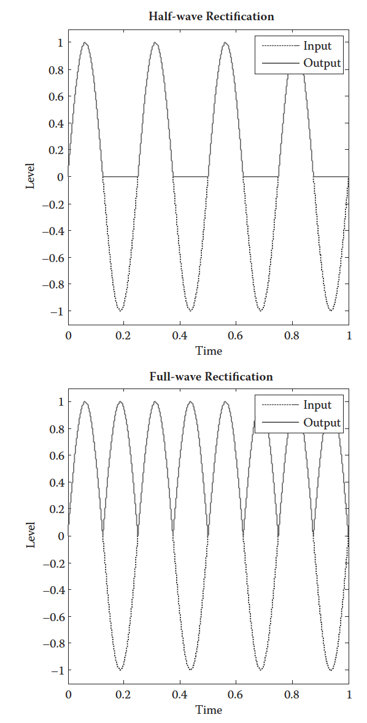
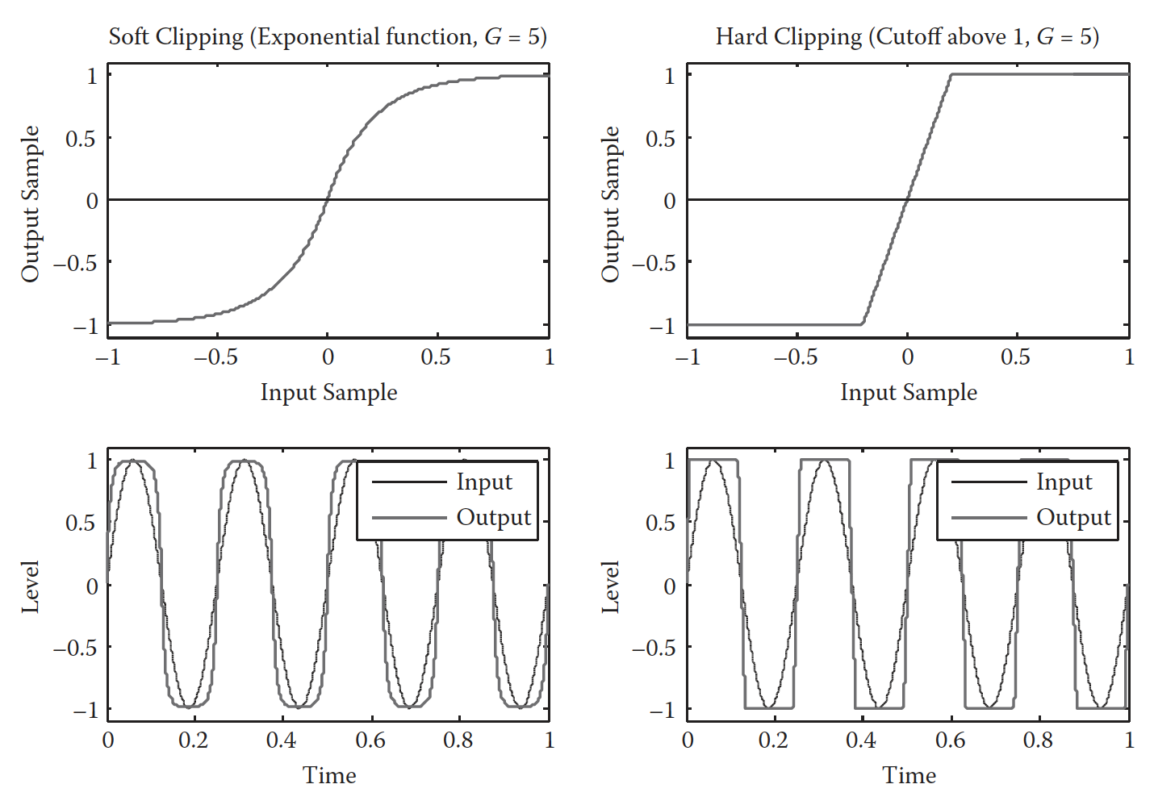
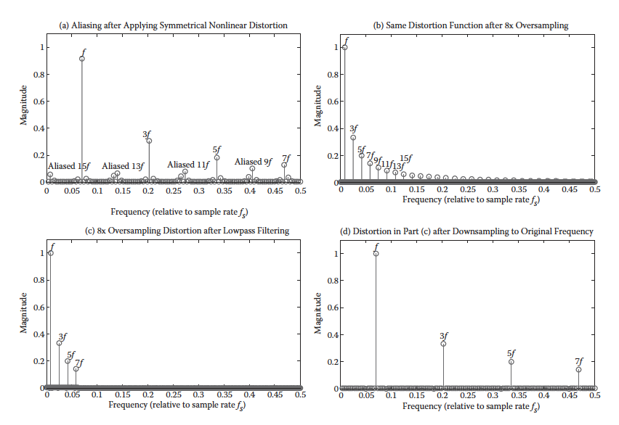
DISTORTION
Non linear effect
Introduction of harmonics

Slide 3
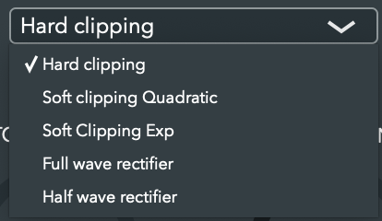

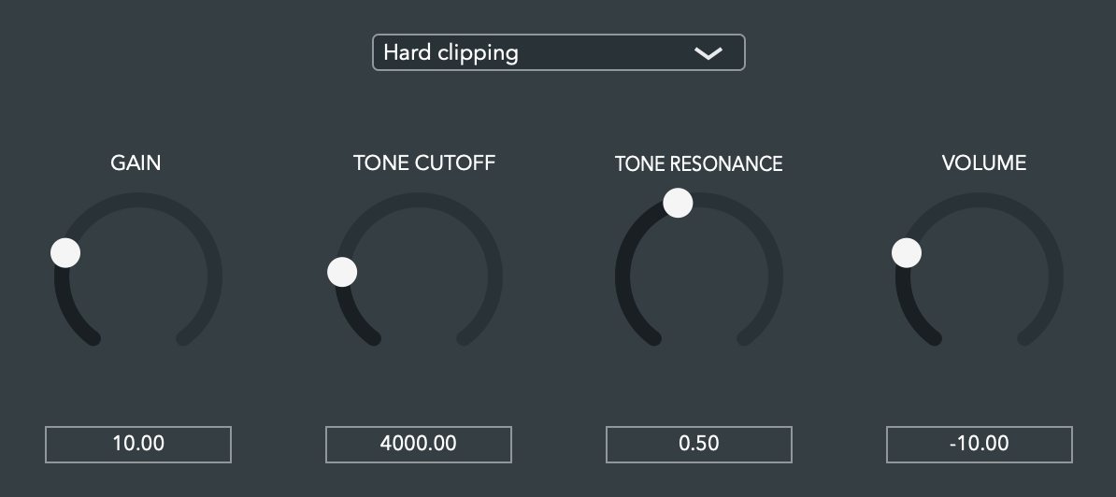




GUI
AudioProcessEditor:
Slider
Combobox
AudioProcessorValueTreeState
AudioProcess

Slide 4












WORKFLOW
Parameters
Filtering
ANTIALIASING
FILTER
TONE
FILTER
CUTOFF
TYPE
RESONANCE
INPUT
OUTPUT
UPSAMPLING
DISTORTION
DOWNSAMPLING
GAIN
VOLUME
- Oversampling
- Antialiasing filter
- Tone filter

Slide 5
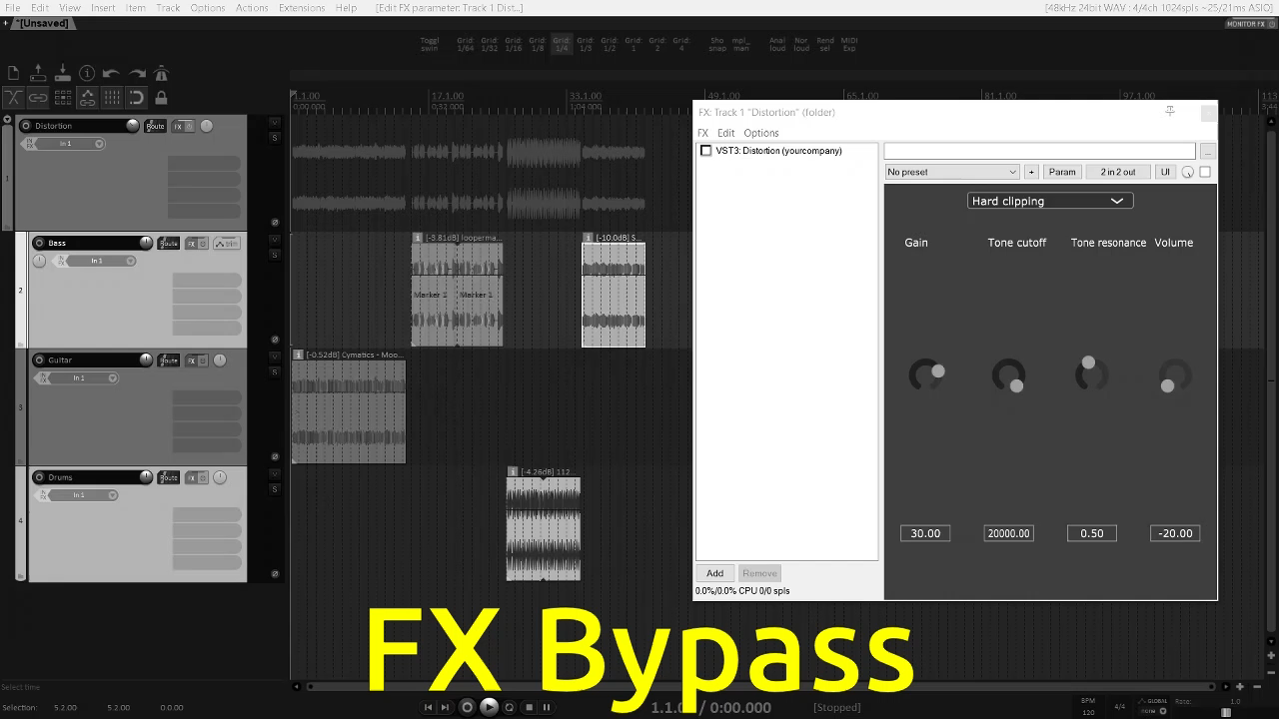
Demo

Slide 6
Thank you for YOUR attention

